Slide 1
Contract Monthly Claim System
ST10442364 Samkelisiwe Hlatshwayo

Slide 2
Overview
The Contract Monthly Claim System (CMCS) is a .NET MVC web-based application designed to streamline the submission, review, and approval of monthly claims for independent contractor lecturers. The system provides role-based dashboards for Lecturers, Program Coordinators, and Academic Managers, ensuring efficiency, accountability, and transparency.

Slide 3
Lecturer Features
Lecturer Dashboard
Quick access
Claim Summary (Total, Pending, Approved, Rejected)
Recent Activity (latest claims with status badges)
Lecturer Claim Page
Filters section (Month selector, Status dropdown, Apply/Reset buttons)
Claims Table (Claim ID, Date, Hours Worked, Hourly Rate, Total, Status)
Lecturer Claim Submission Form Page
Claim Submission Form
Full Name (auto-filled), Module/Claim Title, Hours Worked, Hourly Rate, Total (auto-calculated)
Description / Notes
Submission Date (auto-filled)
File Upload Component (Max file size: 20MB / File Types: .pdf, .docx, .xlsx)
Displays errors if files exceed size or unsupported type

Slide 4
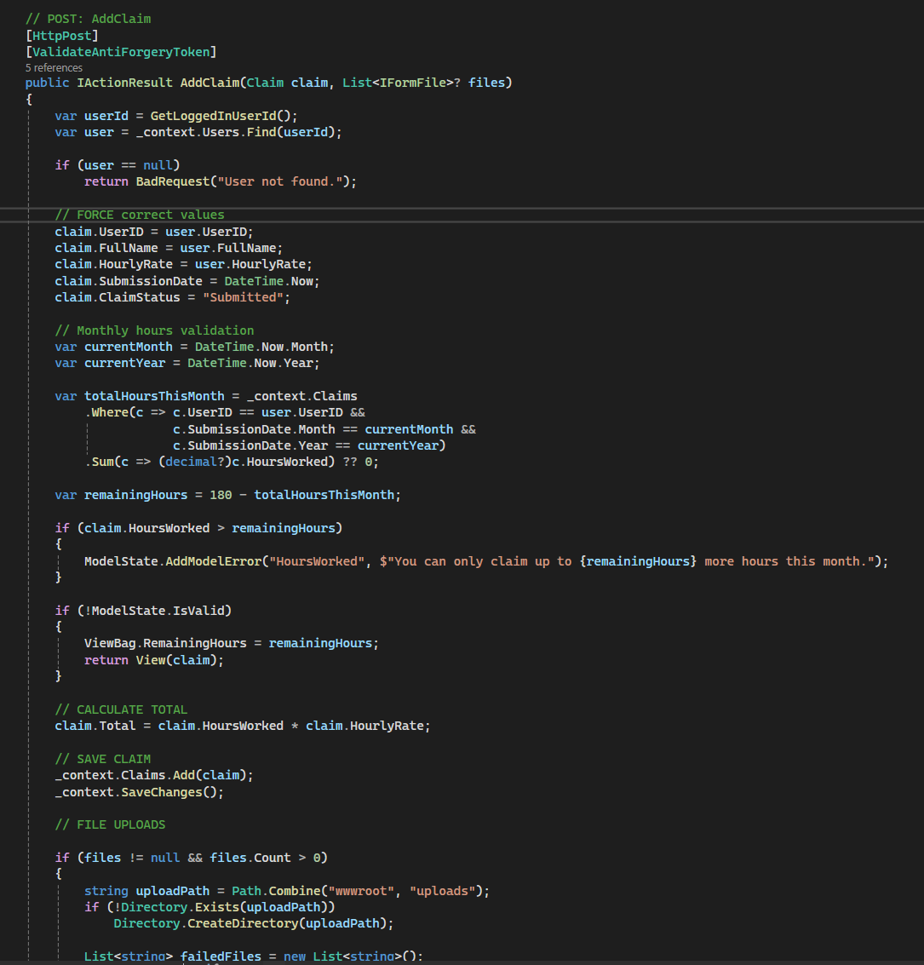
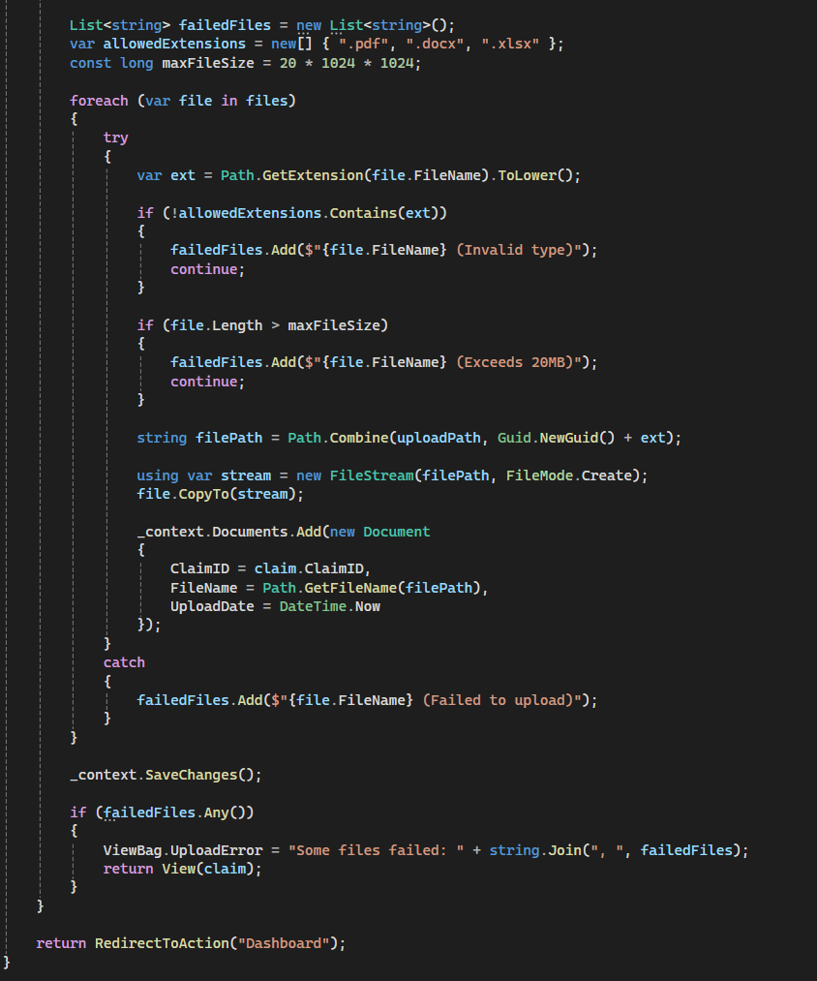
Lecturer Key Feature – Claim Submission

Slide 5
Program Coordinator Features
Program Coordinator Dashboard
Quick access
Claim Summary (Total, Pending, Approved, Rejected)
Program Coordinator Claim Verification Page
Claims table
Filters section (lecturer, claim status, apply/reset button)
Approve/Reject and claim detail buttons
Program Coordinator Review Claim Page
Claim details and uploaded documents display
Feedback text area
Approve/Reject and "Back to claims" button

Slide 6
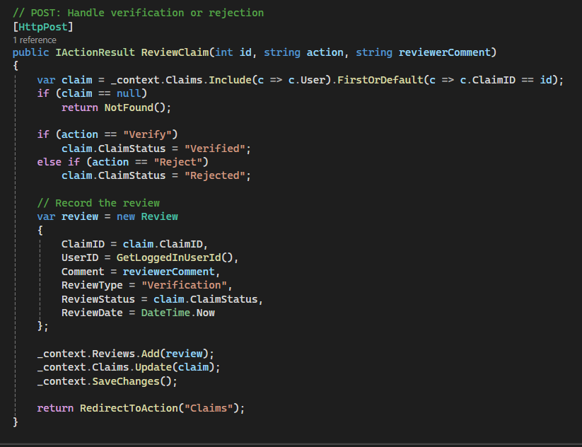
Program Coordinator Key Feature – Claim Verification/Rejection

Slide 7
Academic Manager Features
Academic Manager Dashboard
Quick access
Academic Manager Claim Page
Claims table
Filters section (Lecturer/Claim ID, Month, Apply/Reset buttons)
Approve/Reject and claim detail buttons
Academic Manager Review Claim Page
Displays coordinator verification status
Claim details and uploaded documents display
Feedback text area
Approve/Reject and "Back to pending claims" button

Slide 8
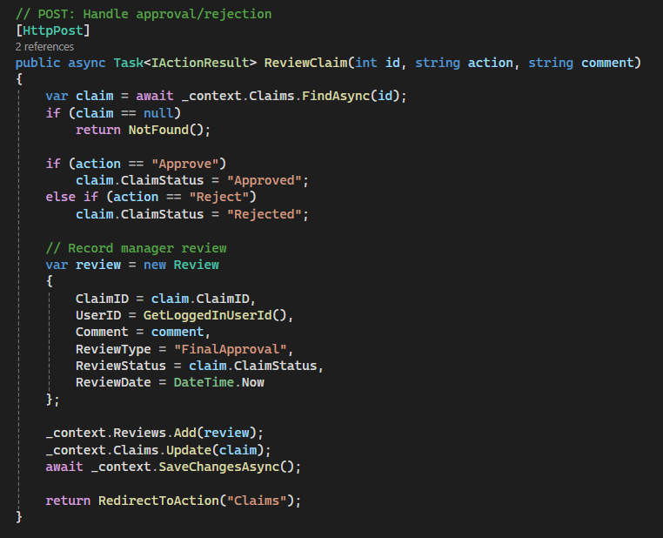
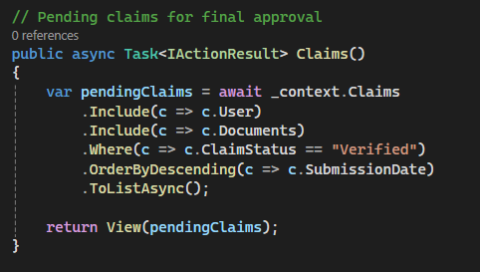
Academic Manager Key Feature – Claim Approval/Rejection

Slide 9
Part 3 Features
Role-Based Login System
HR User Management (Add/Edit Users)
Automation and Validation (Hourly Rate and Claimable Monthly Hours)
Reports PDF generation

Slide 10
Role-Based Login System
Validates user input on login.
Checks the database for a matching email and password using Entity Framework.
If a match is found, stores user details in session variables: UserID, Role, and FullName.
Redirects the user to the appropriate dashboard based on their role (role-based access control).
Displays an error if authentication fails.
Clears the session upon logout to securely end the login.

Slide 11
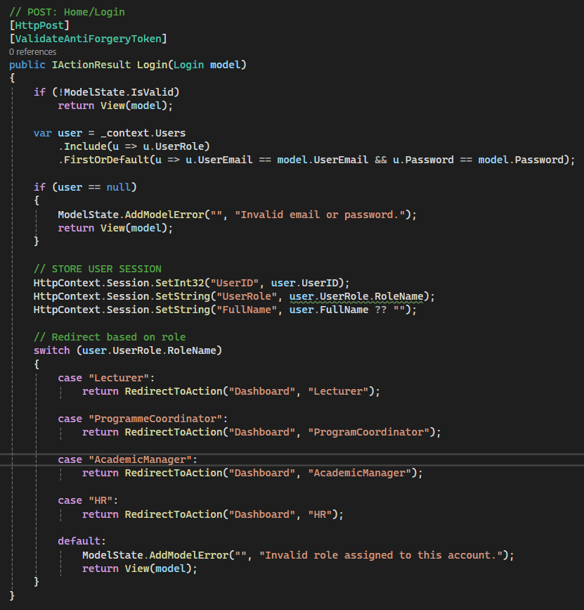
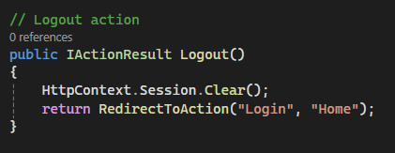
Role-Based Login & Logout Method

Slide 12
HR User Management
HR can create and update user accounts directly within the system.
CreateUser:
  Loads all available roles into a dropdown.
  Saves the new user to the database after form submission and validation.
EditUser:
  Retrieves the selected user’s current details.
  Preloads their assigned role for easy editing.
  Allows HR to update any information.
After validation, updated user data is saved to the database using Entity Framework.

Slide 13
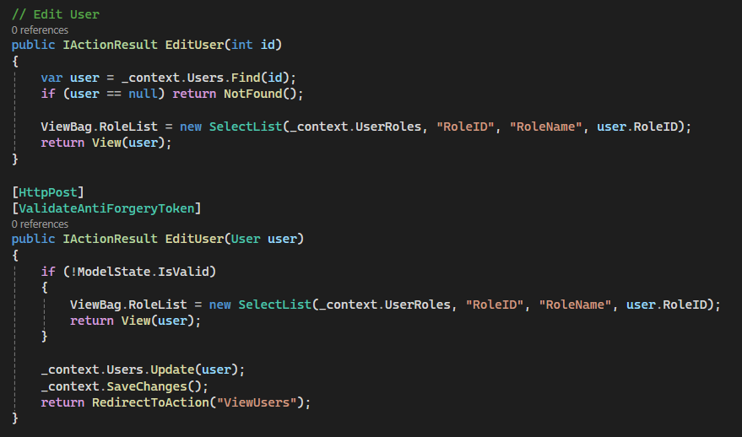
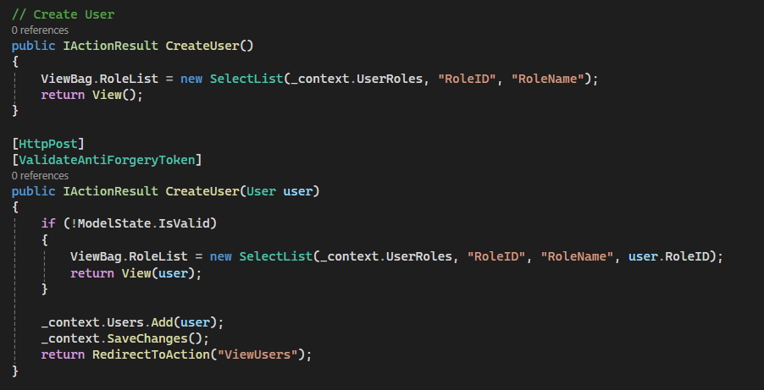
HR Key Feature – Add / Edit User

Slide 14
Automation and Validation
The system automatically pulls key claim values from the logged-in user to ensure accuracy and prevent tampering.
The lecturer’s HourlyRate is taken directly from their user profile, so it cannot be changed manually.
The system checks all previously submitted claims for the current month and adds up the total hours already claimed.
It calculates the remaining allowable hours and blocks any claim that exceeds the monthly limit.
After validation, the Total Amount is automatically calculated as HoursWorked × HourlyRate.

Slide 15
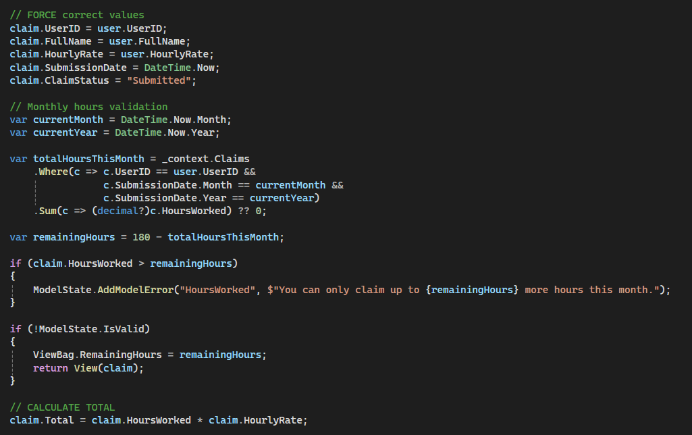
Automation and Validation Code

Slide 16
Reports PDF Generation
Reports Method
Generates On-Screen Report Using LINQ
Starts by loading all claims and including the related user (lecturer).
Applies filters (month, lecturer, status) only if the user selects them.
Groups the filtered claims by lecturer name.
Calculates each lecturer’s Total Hours and Total Amount.
Prepares dropdown lists for Month, Lecturer, and Status.
Passes the final grouped data to the View so HR can see the report on screen.
DownloadReport Method
Exports the Same Report to PDF
Repeats the same filtering steps used in the Reports method.
Groups filtered claims by lecturer and summarizes totals.
Uses iText7 to create a PDF document.
Adds a title, lecturer headings, and a table listing all claim details.
Writes total hours and total amount for each lecturer.
Builds a dynamic filename based on the selected filters.
Returns the PDF file for download.

Slide 17
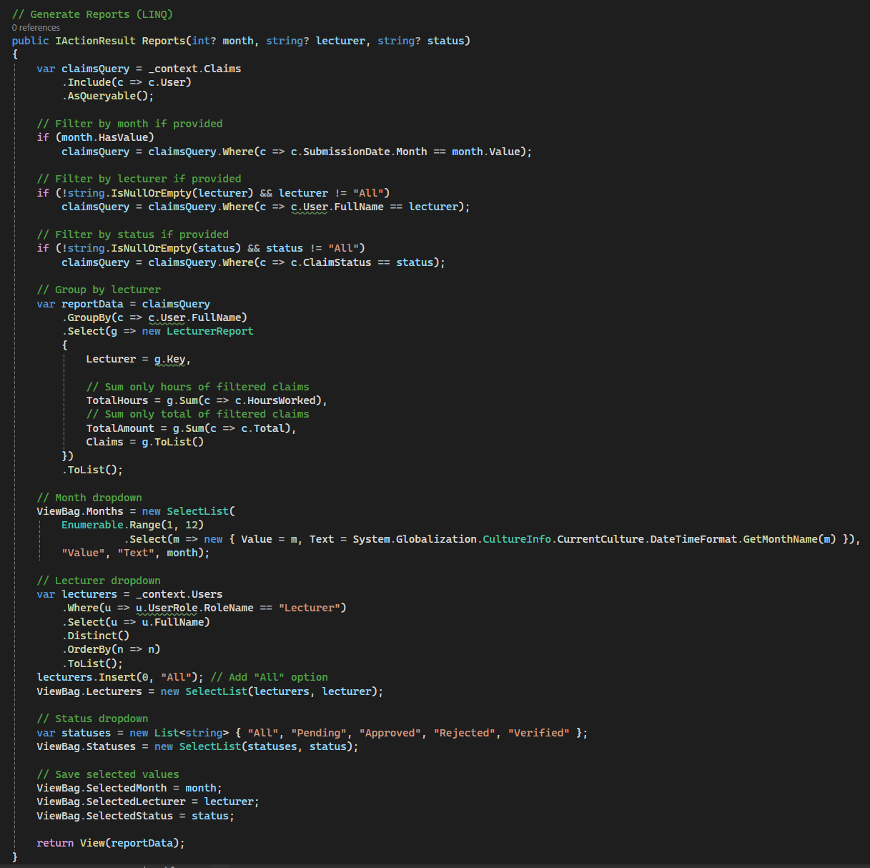
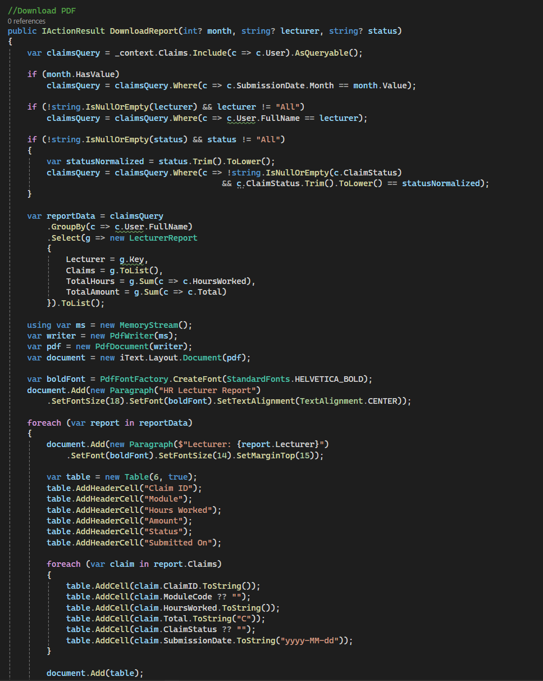
Reports PDF Generation Code

Slide 18
Thank You

